Slide 1
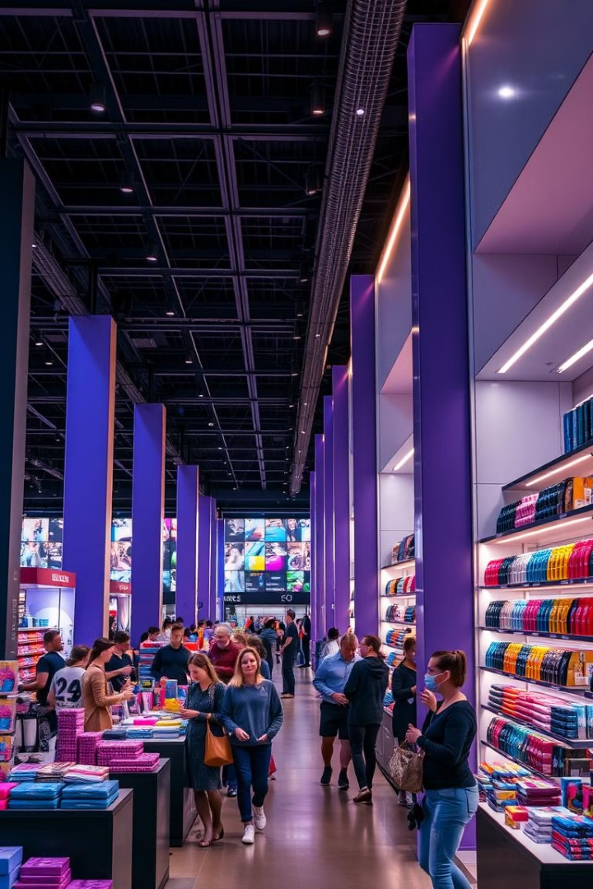
Retail Store Sales Optimization
This presentation will explore the optimization of retail store sales using data analytics, focusing on identifying sales patterns, optimizing product placement, and forecasting future trends.
sm
by seema m

Slide 2
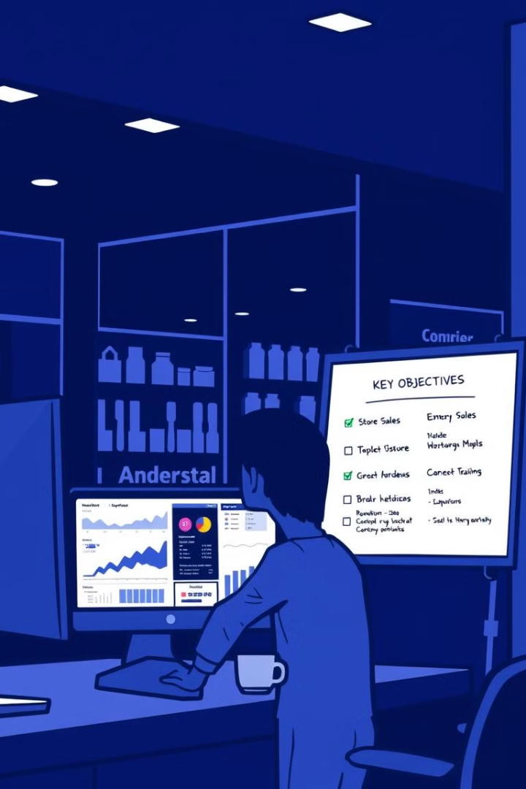
Project Objectives
1
Identify Purchasing Patterns
2
Optimize Product Placement
Analyze customer purchase behavior to understand trends and preferences.
Improve product visibility and accessibility to boost sales.
3
Forecast Future Trends
Predict future sales based on historical data to inform inventory management and marketing strategies.

Slide 3
Tools & Technologies
Python
Power BI
Excel
MySQL
For exploratory data analysis, data preprocessing, and forecasting.
For creating interactive dashboards and visualizations to analyze sales trends.
For data cleaning, preprocessing, and basic data analysis.
For data storage, management, and querying.

Slide 4

Problem Statement
Retail businesses face challenges in understanding customer purchase behavior, optimizing inventory management, and predicting future sales trends. This project analyzes retail sales data to improve business performance by uncovering key sales patterns, identifying top-performing products and stores, optimizing inventory management, and forecasting future sales trends.

Slide 5

Dataset Overview
The Superstore Sales dataset includes key columns such as Product ID, Category, Store ID, Date, Sales, Discount, and Profit, allowing us to analyze sales trends, customer behavior, and profitability across products and stores.

Slide 6

Data Cleaning Process
Ensuring Data Consistency
Handling Missing Values
Converted date columns to the correct date format, checked and rectified outliers and incorrect data types.
Removing Duplicates
Filled missing values in numerical columns with the mean or median, and in categorical columns with the mode.
Identified and removed duplicate rows to maintain data integrity.

Slide 7
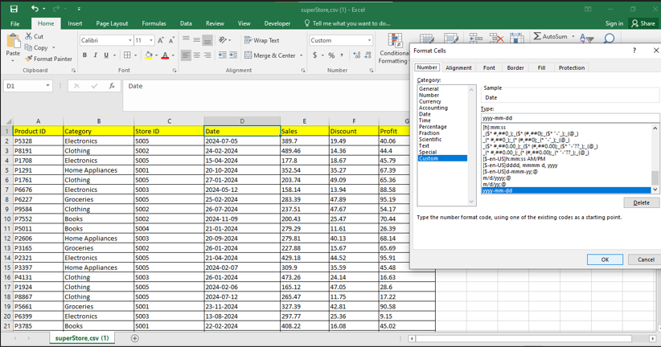
Key Insights from Cleaned Dataset
The cleaned dataset reveals insights into seasonal sales trends, top-performing products and stores, the correlation between discounts and profit, customer purchasing behavior, and sales distribution across categories.

Slide 8
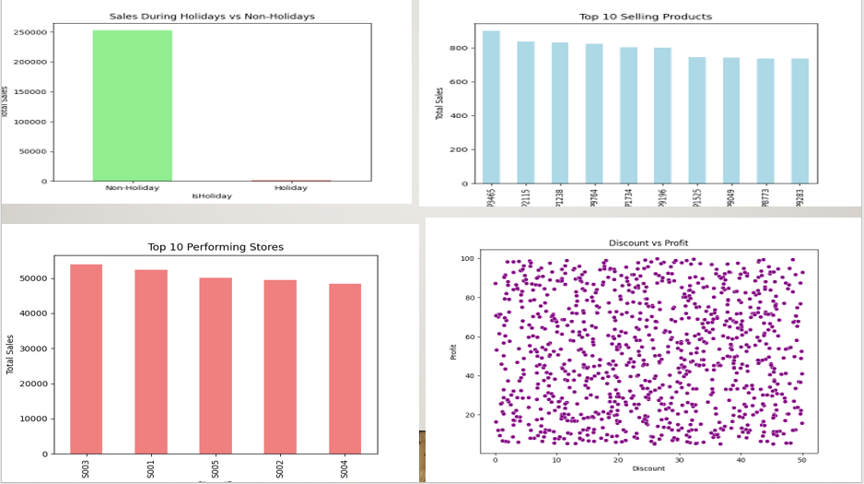
Analyzing Seasonal Trends

Slide 9
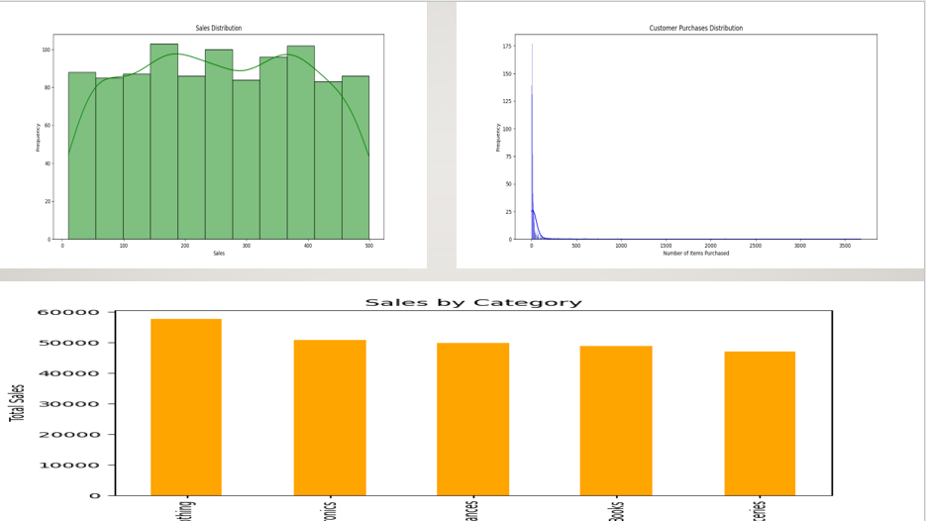
Analyzing Seasonal Trends

Slide 10

Data Visualization with Power BI
Sales Trends Over Time
Analyze revenue patterns across different time periods.
Product Category Performance
Identify top-performing categories and products.
Profitability Analysis
Compare profit margins across stores and products.
Impact of Discounts on Sales
Evaluate how discounts influence revenue and profit.

Slide 11
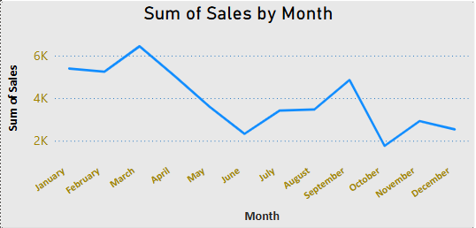
Sales Trend Over Time

Slide 12
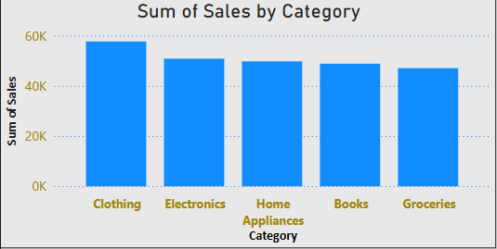
Top-Selling Products

Slide 13
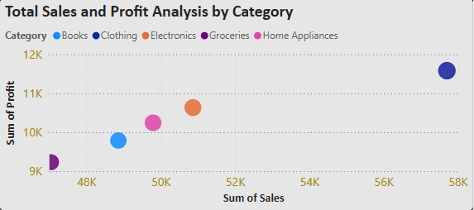
Profitability by Product

Slide 14
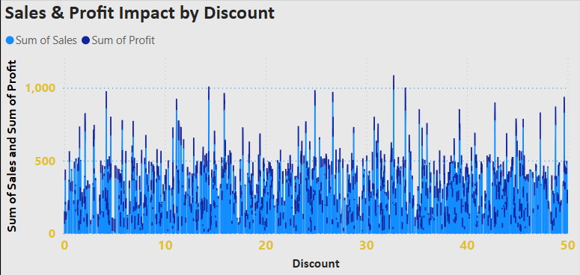
Impact of Discounts on Sales

Slide 15
Conclusion
The analysis reveals total sales of $254,256.90 and a profit of $51,483.13. Clothing was the top-selling category, while Groceries had the lowest sales. Store S003 performed best, whereas Store S004 underperformed, requiring further evaluation. Discounts had minimal impact on both sales and profit, suggesting a need for a refined pricing strategy.

Slide 16




Recommendations for Optimization
Inventory Optimization
Store Performance Improvement
Discount Strategy Refinement
Focus on high-demand categories like Clothing while reevaluating the sales strategy for Groceries.
Refine the discounting strategy, as excessive discounts do not significantly impact sales or profit.
Investigate the underperformance of Store S004 to identify possible operational inefficiencies or low customer engagement.

